Slide 1
The 2017 Scarecrow Trail
St Thomas a Becket Church would like to thank all the good people of Pucklechurch who made this event so successful.
To those who made the Scarecrows, to those who walked round to find them, to those who made the sandwiches cakes and cups of tea, coffee and other drinks,
THANK YOU

Slide 2
I get knocked down But I get up again! Can you get this man?(anagram)
Agent Smith

Slide 3
Frightening seasoning
Scary Spice

Slide 4
Tomorrow is another day
Scarlet O’Hara

Slide 5
A Black Dog?
Sirius Black

Slide 6
The alter-ego of Mr. Kent
Superman

Slide 7
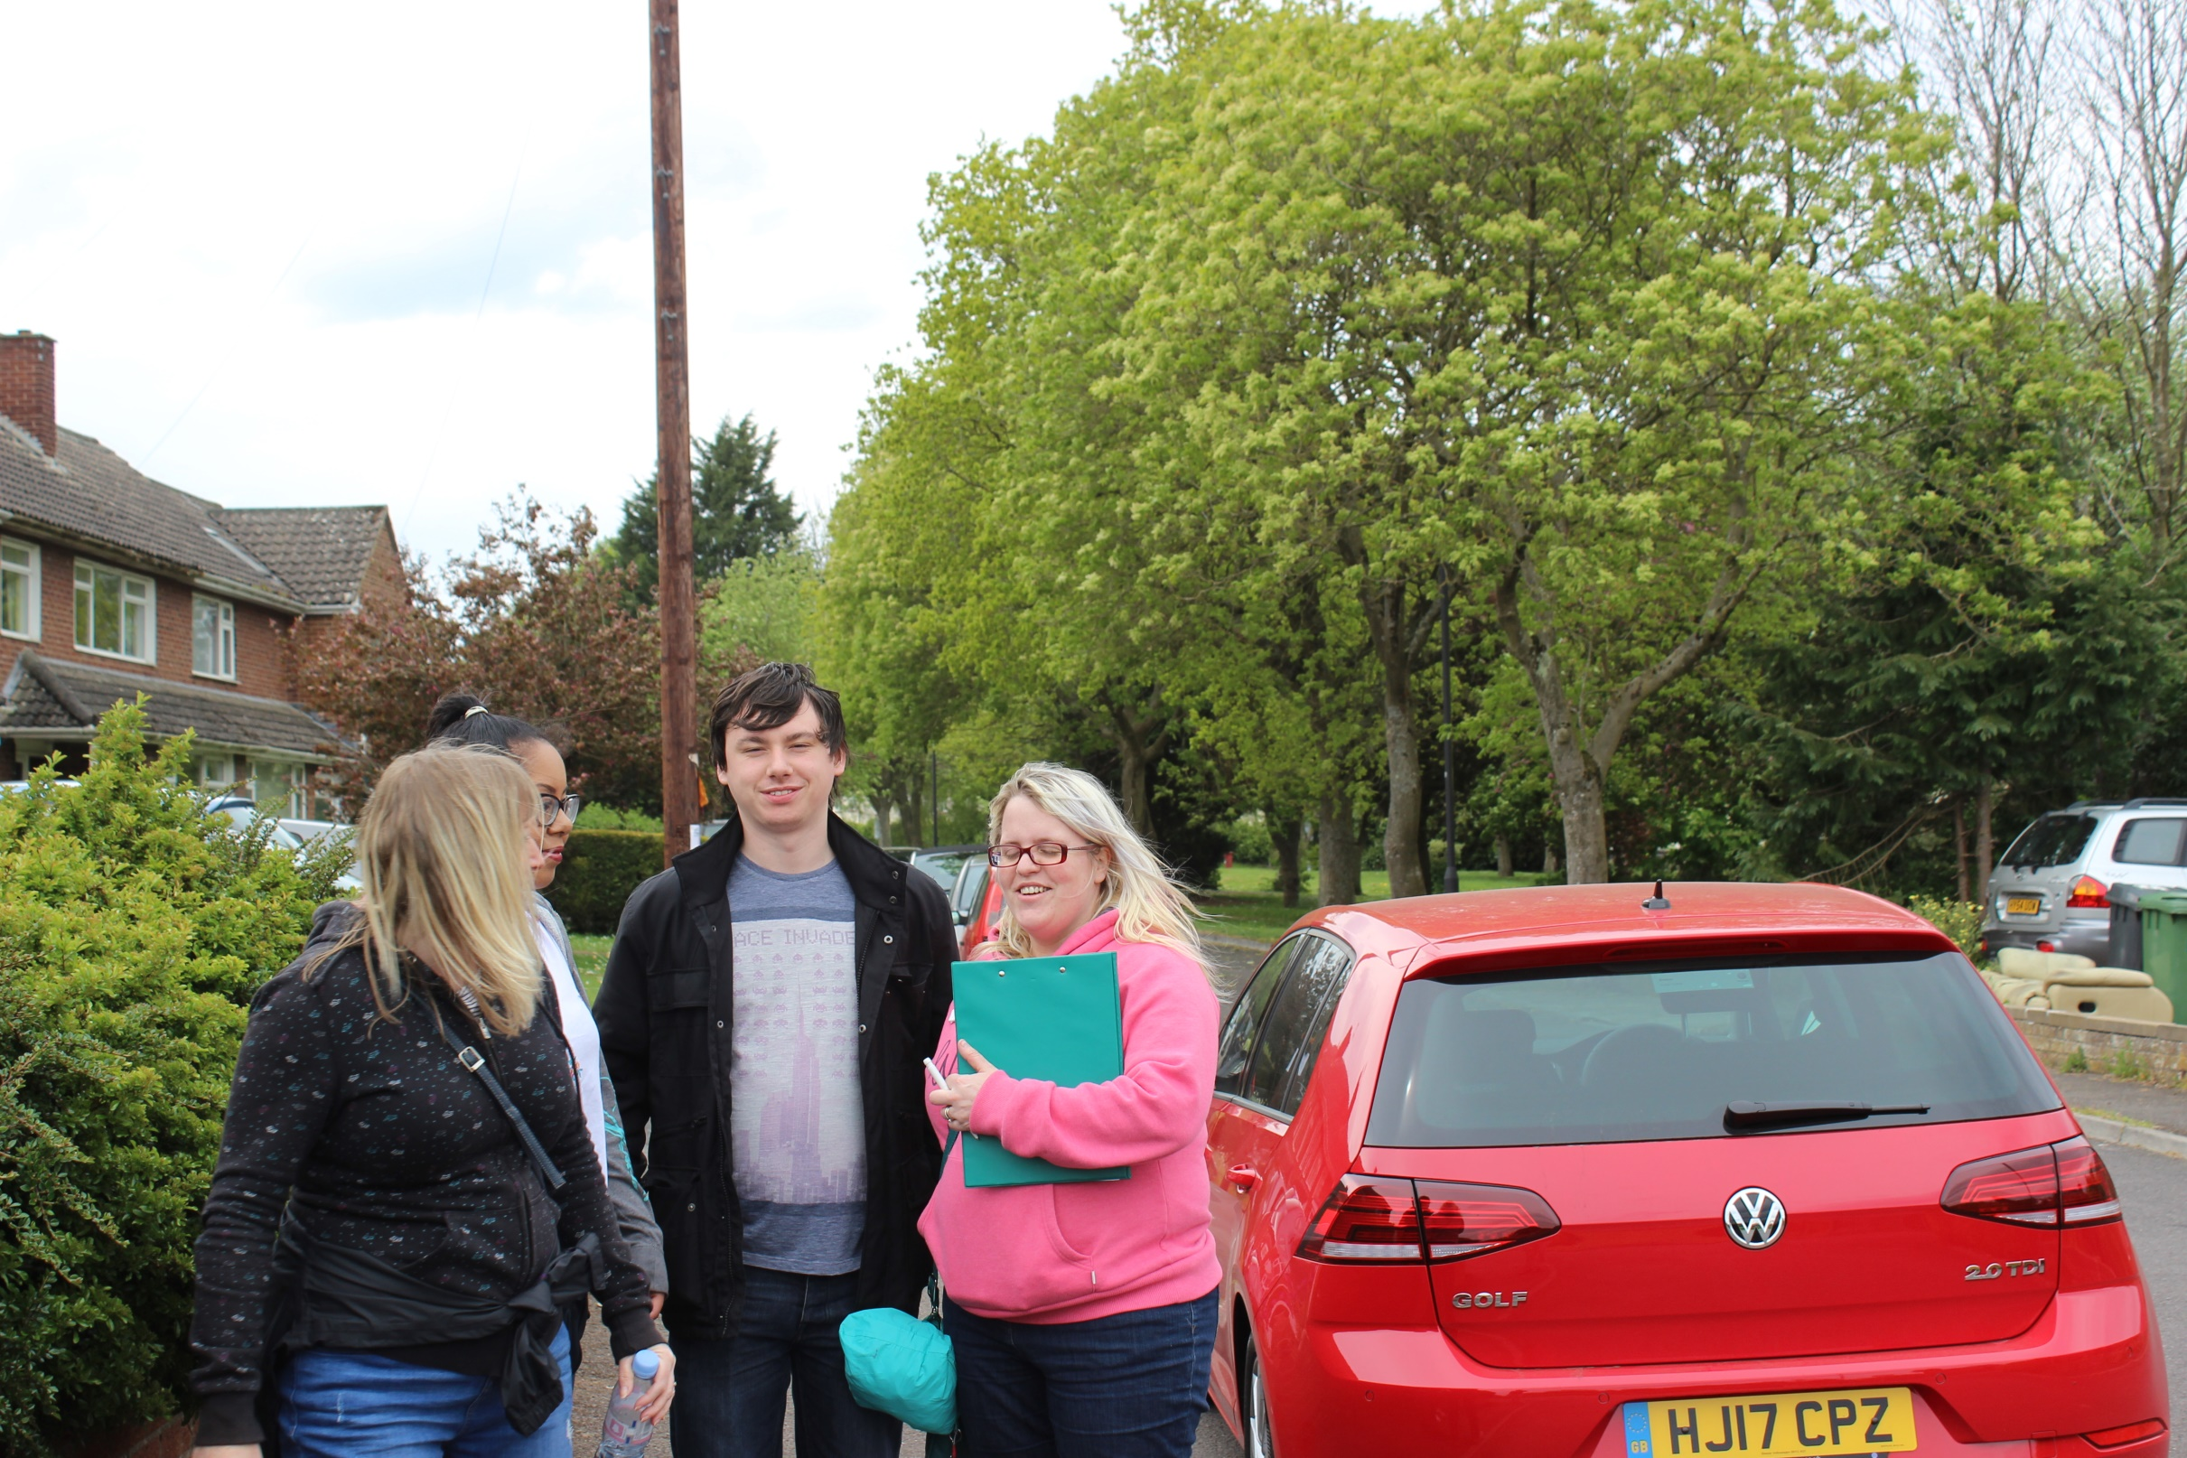

Slide 8
This person likes to help people to become a star.
Simon Cowell

Slide 9
Alex’s blocky friend
Steve from Minecraft

Slide 10
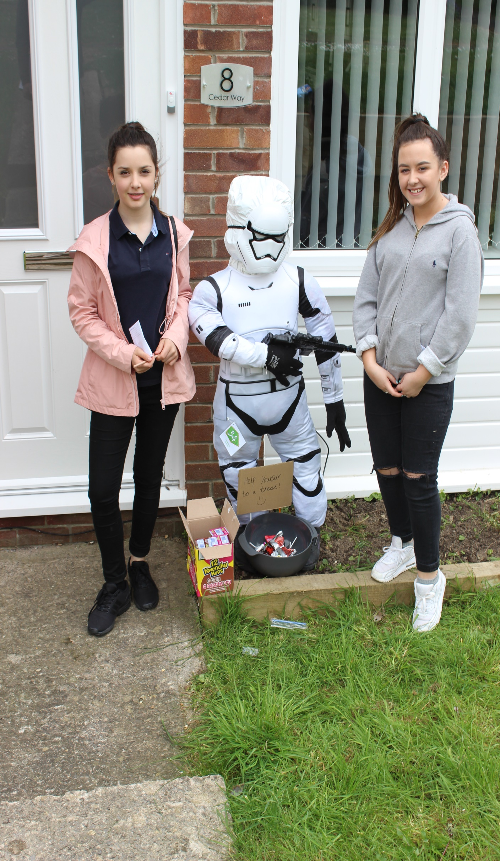

Slide 11
---- on the job Bob.
Spud the Scarecrow from Bob the Builder

Slide 12
A Little ray of ? On a Cloudy day.
Little Miss Sunshine

Slide 13
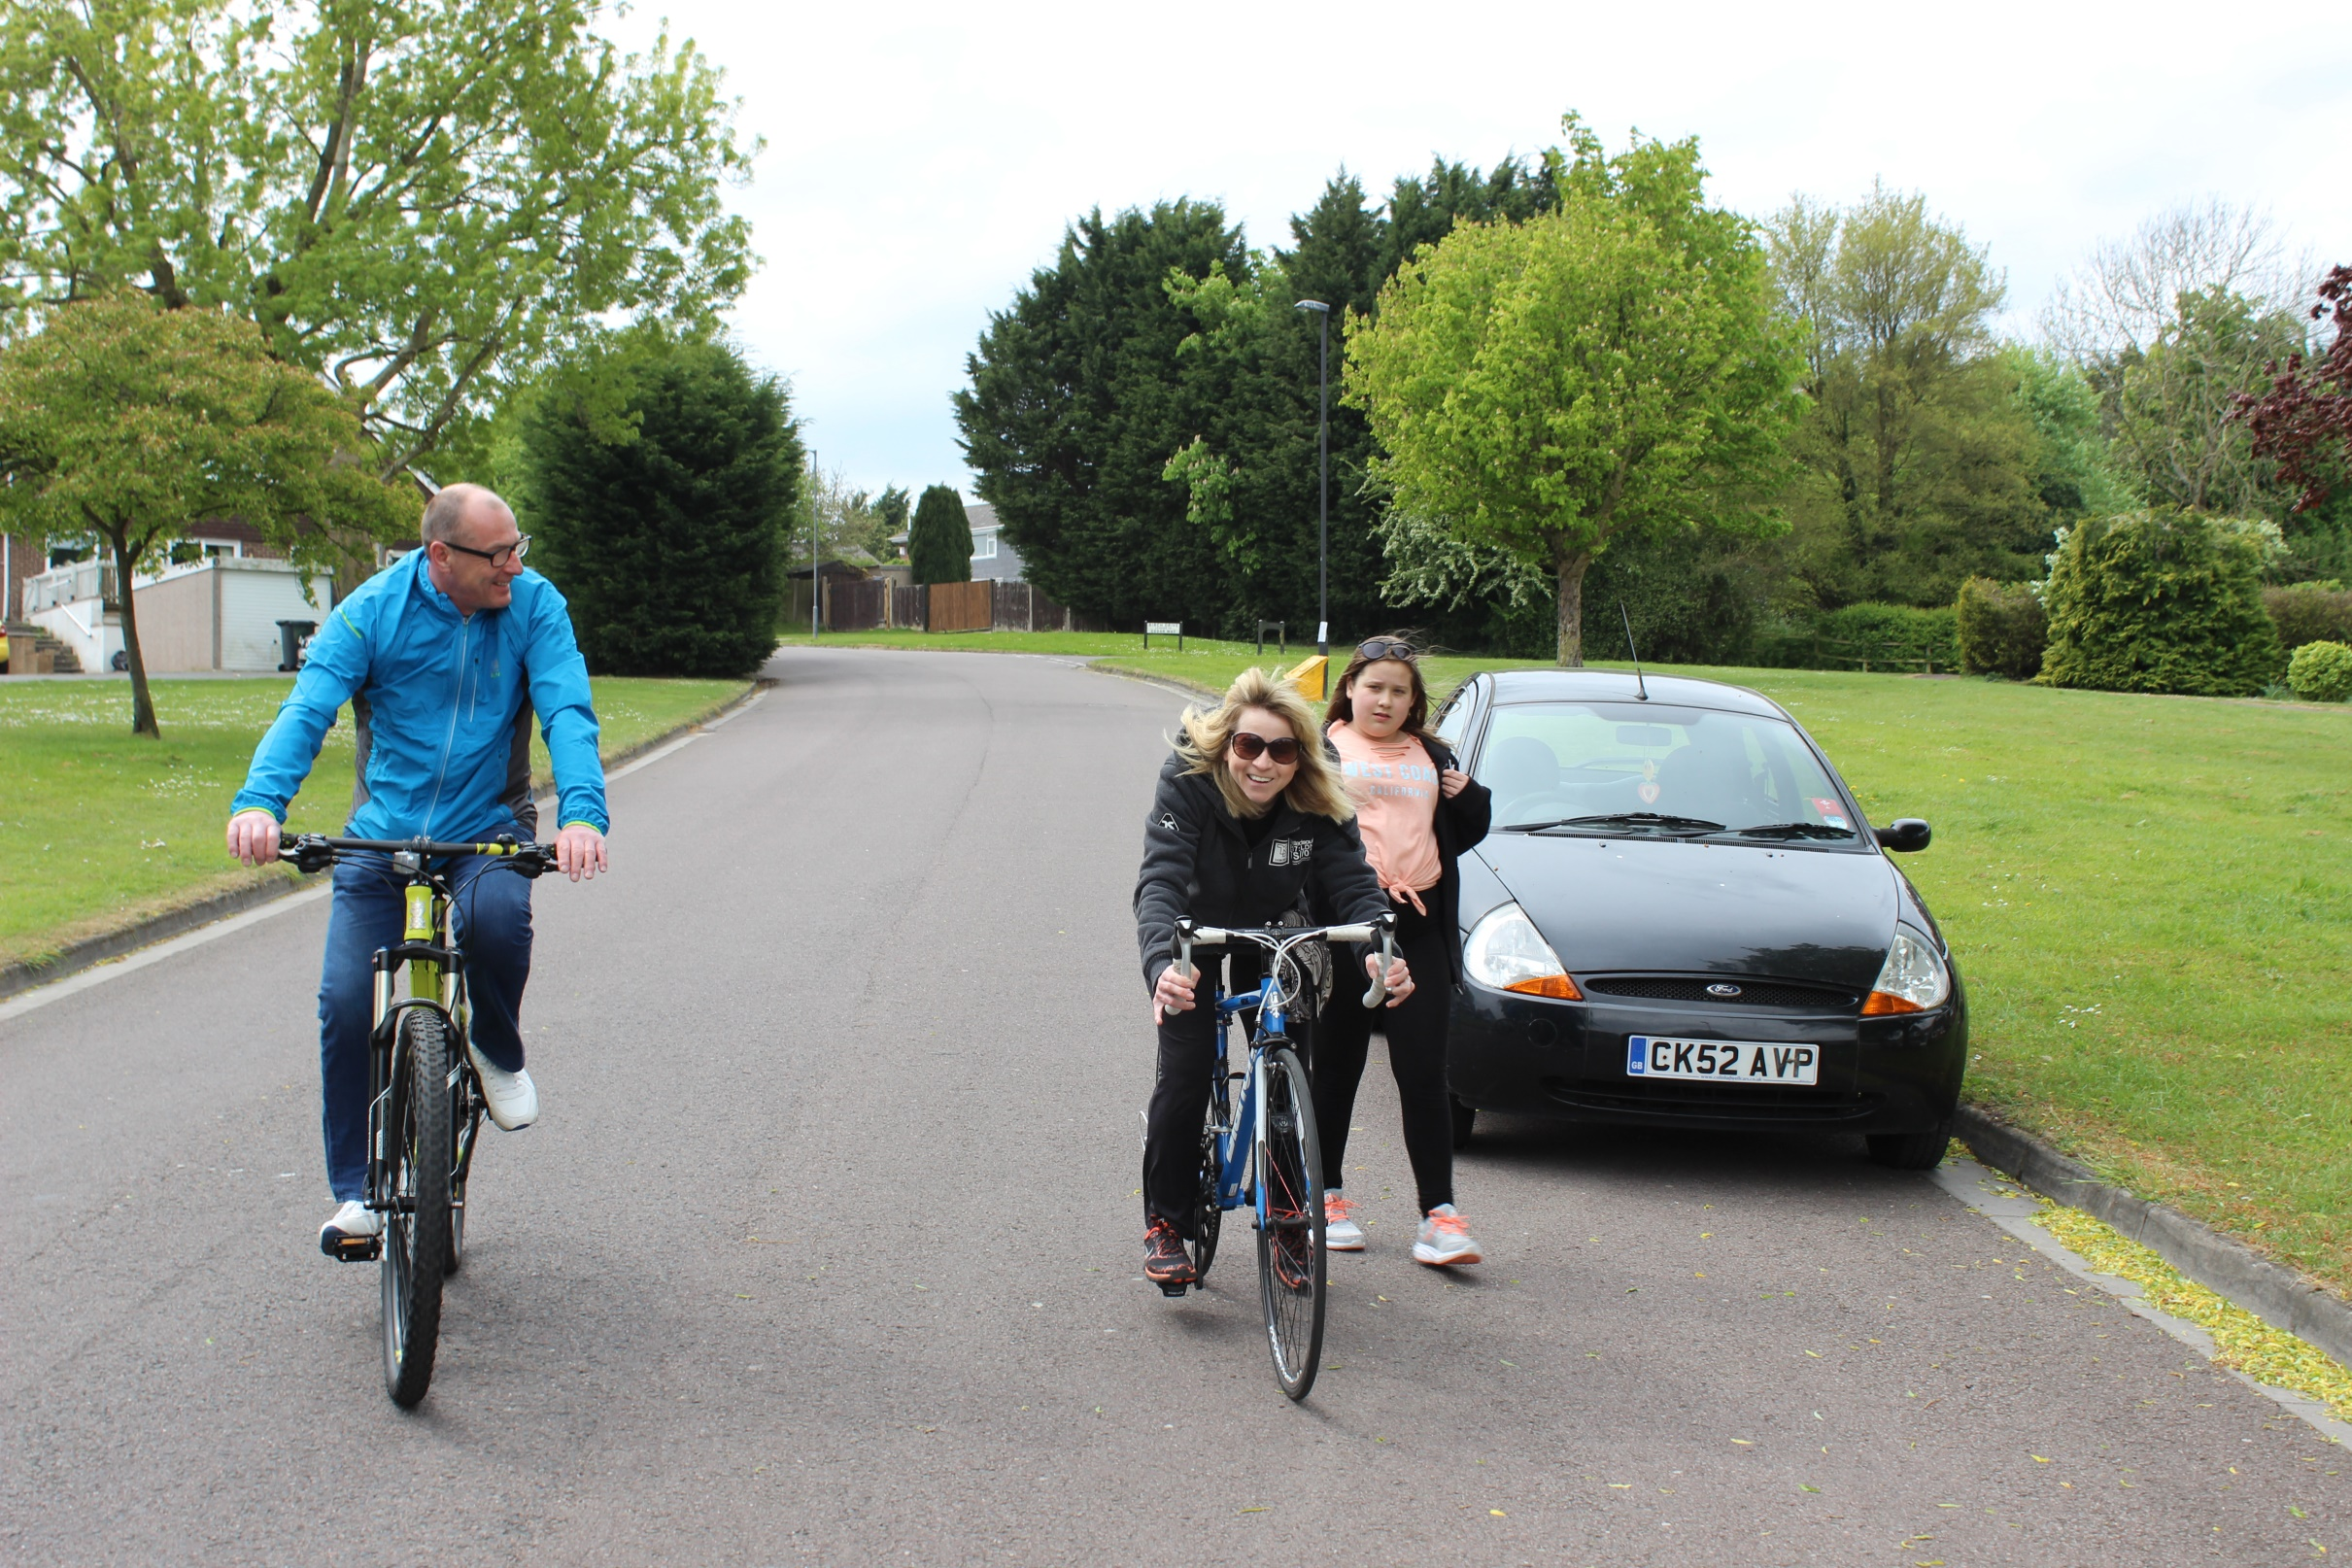

Slide 14
My best Friend is Woodstock
Snoopy

Slide 15
Am I too Late?
Santa Claus

Slide 16
Marvellous and Mystical MD.
Doctor Strange (Marvel comics)

Slide 17
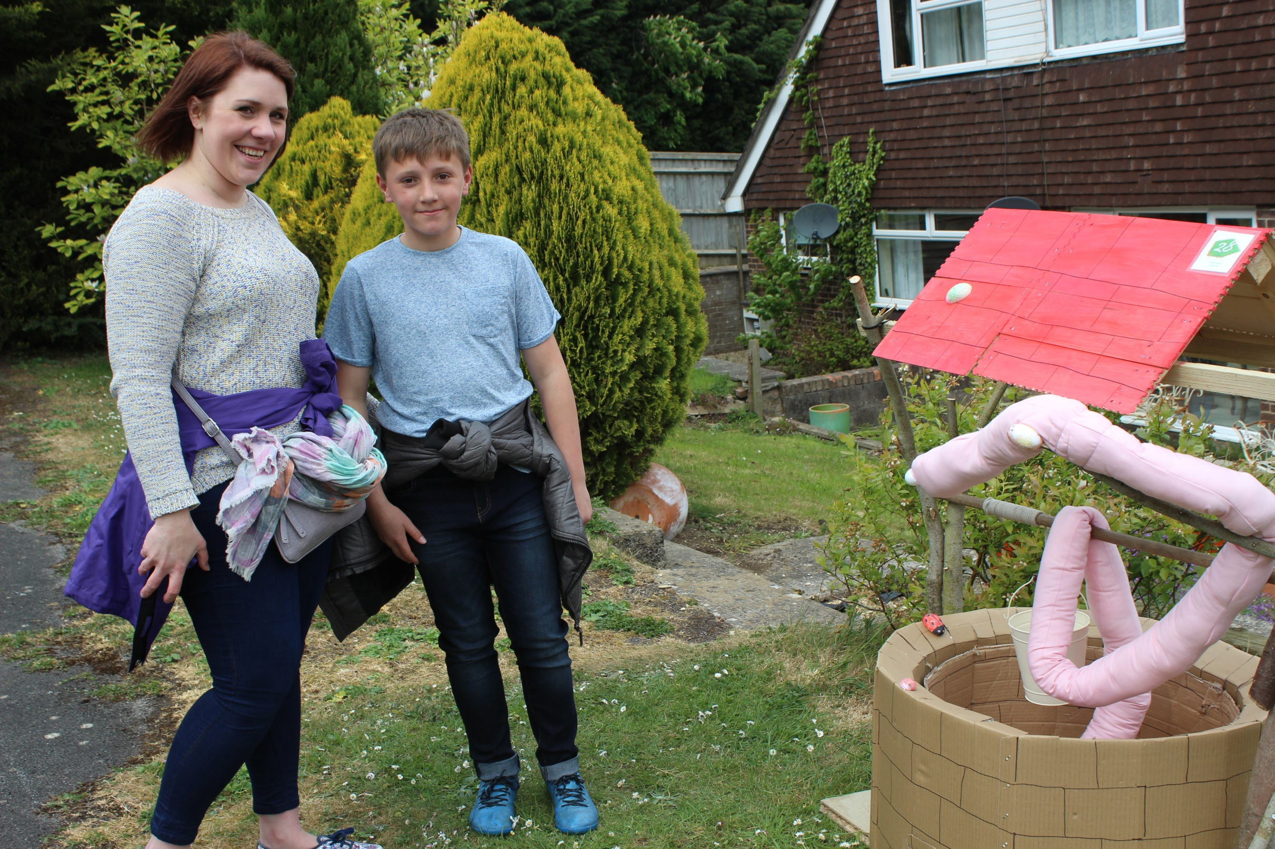

Slide 18
Trying to get back to his Stick Lady Love.
The Stick Man

Slide 19
He has a thing about snakes.
Severus Snape

Slide 20
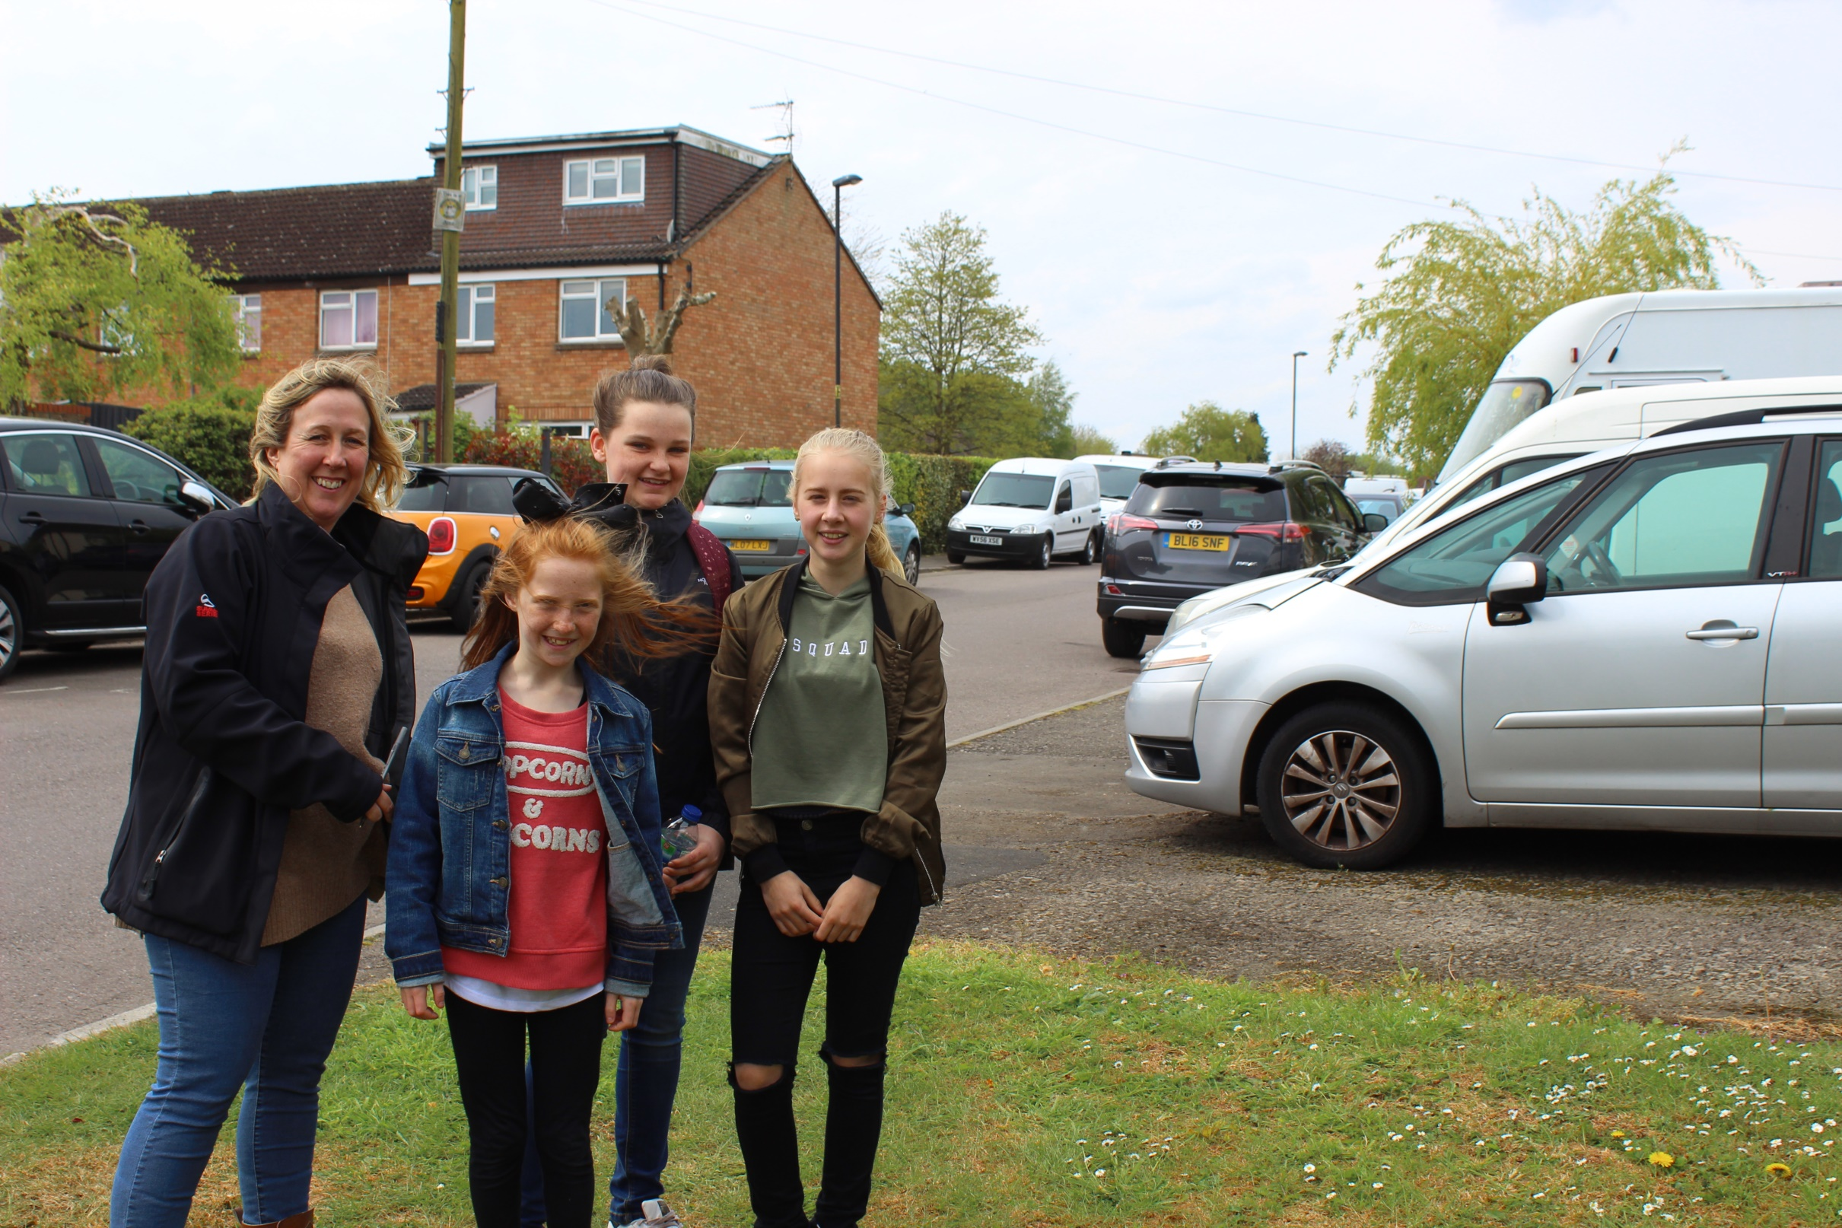

Slide 21
Can be bad as well.
Sinbad

Slide 22
The small, charming rodent Snowbell wanted to get rid of
Stuart Little

Slide 23
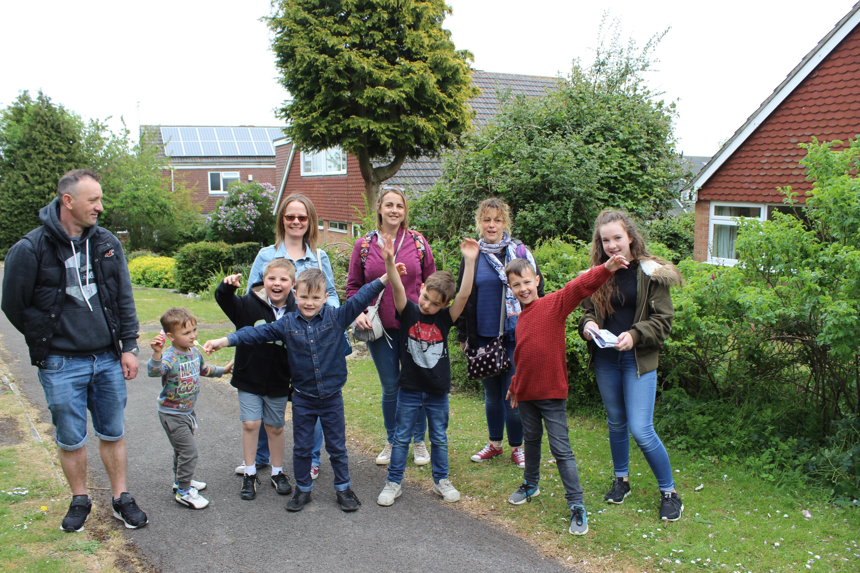

Slide 24
‘Crikey’
Steve Irwin

Slide 25
A cute little blue creature
Smurf

Slide 26
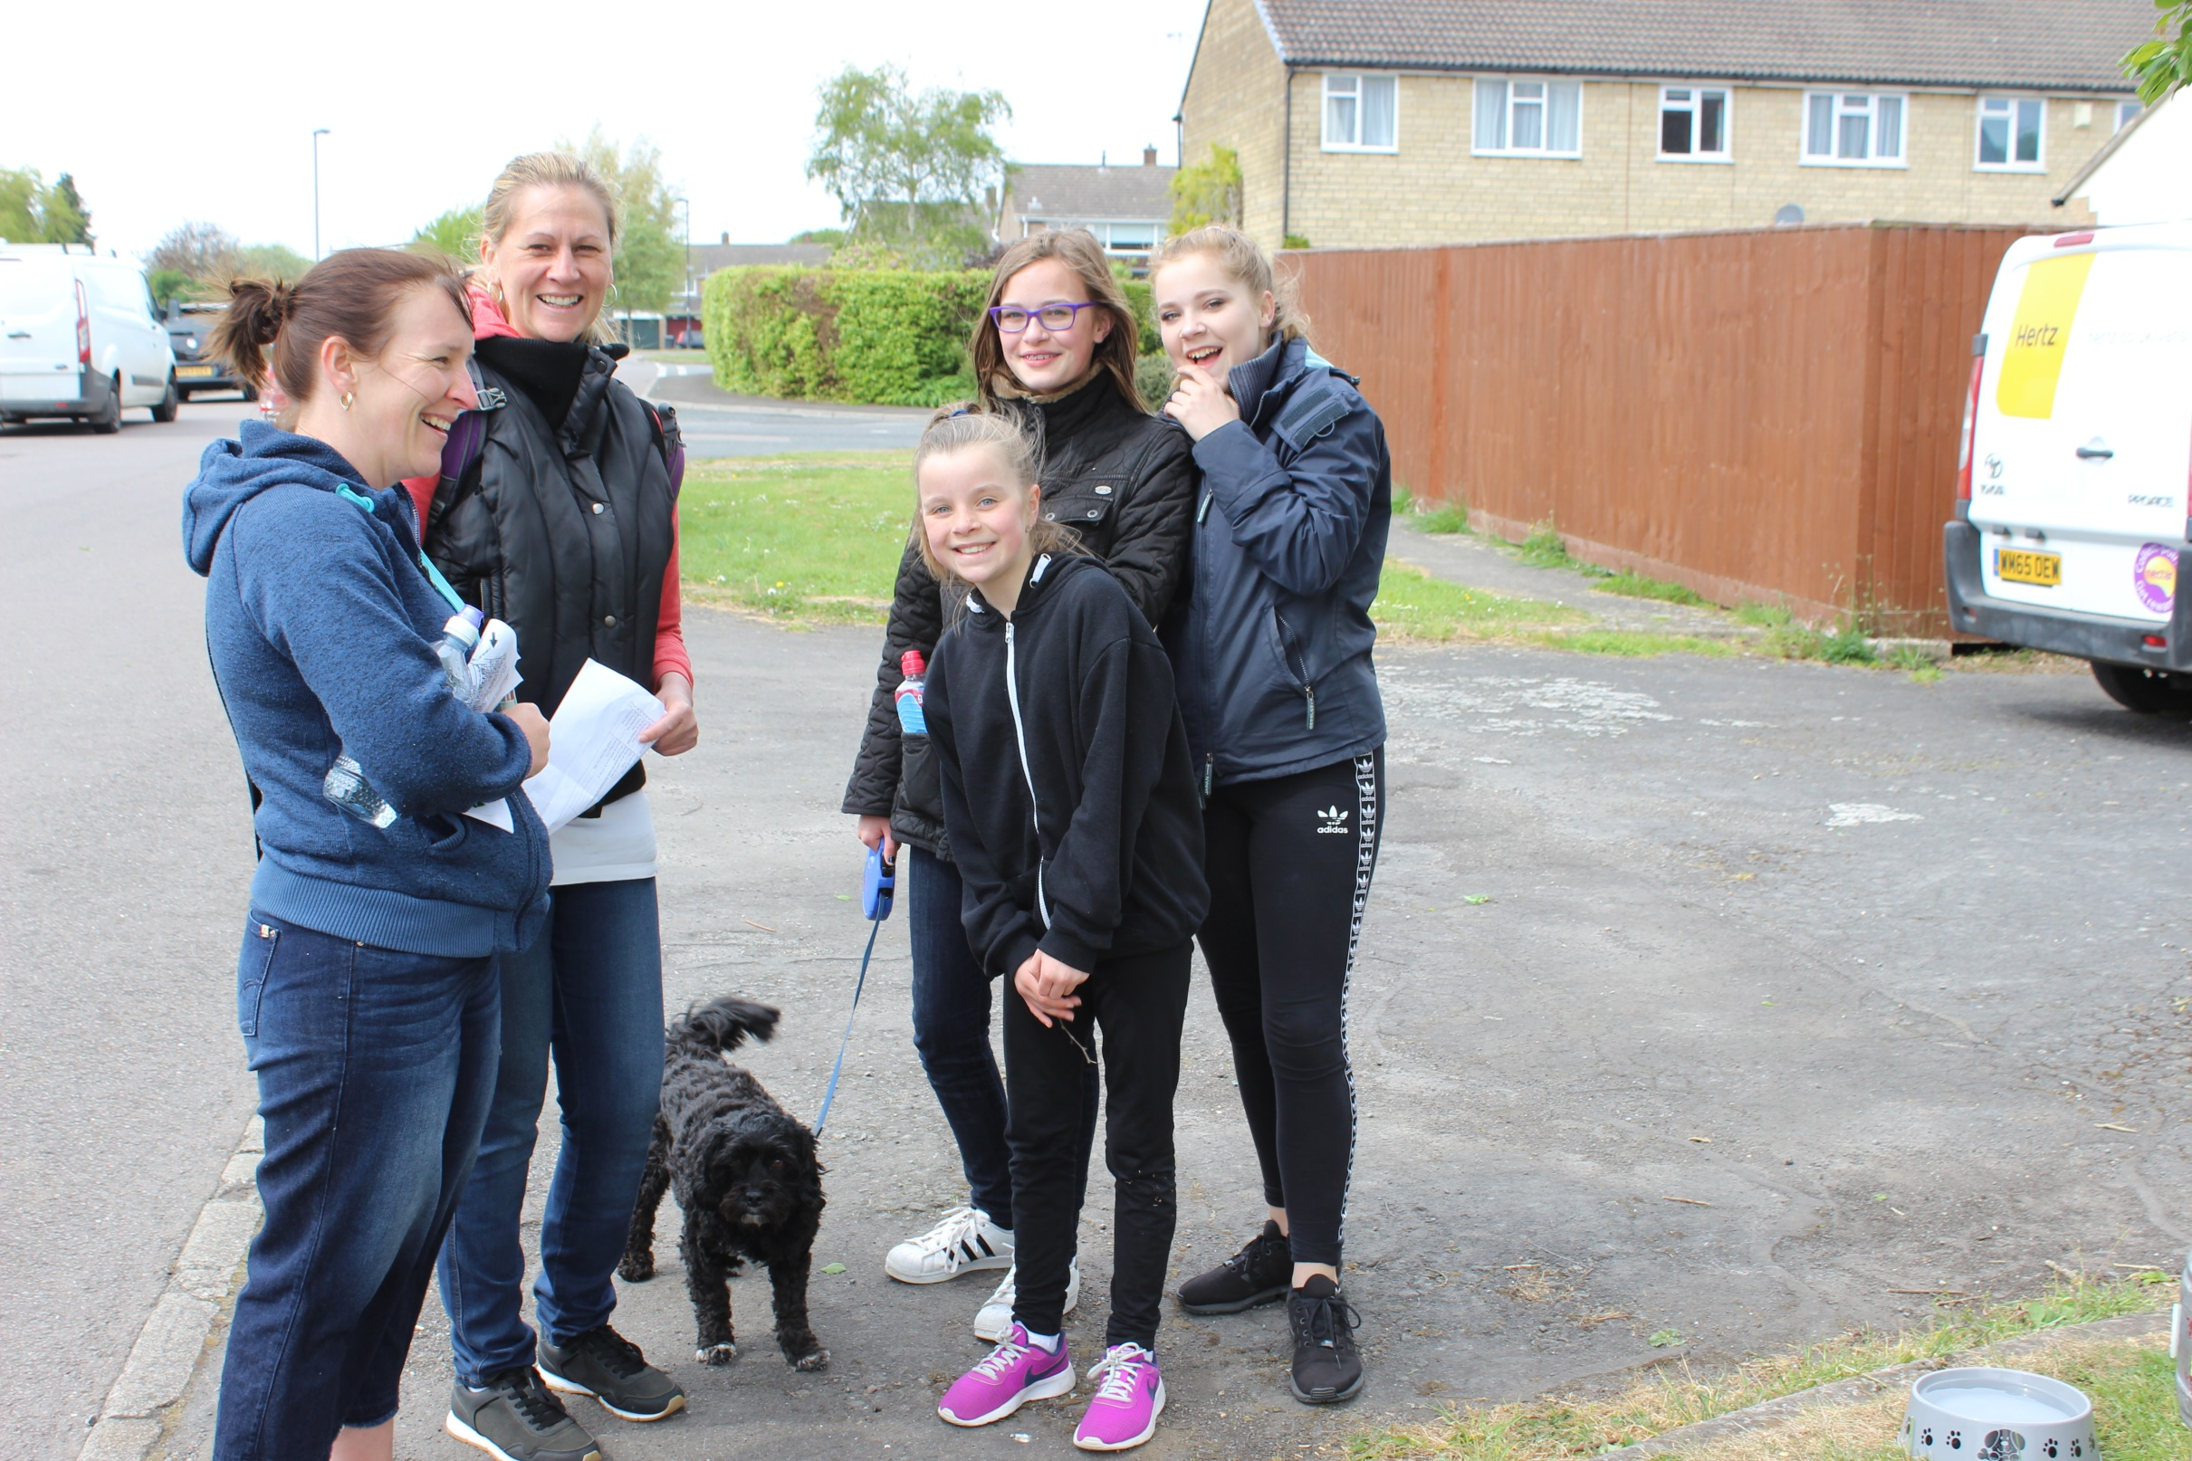

Slide 27
Being second is to be first of the ones who lose.
Ayrton Senna

Slide 28
My home is usually lives in the Alps.
St. Bernard dog.

Slide 29
She has had breakfast with the Queen.
Sophie(from the BFG)

Slide 30
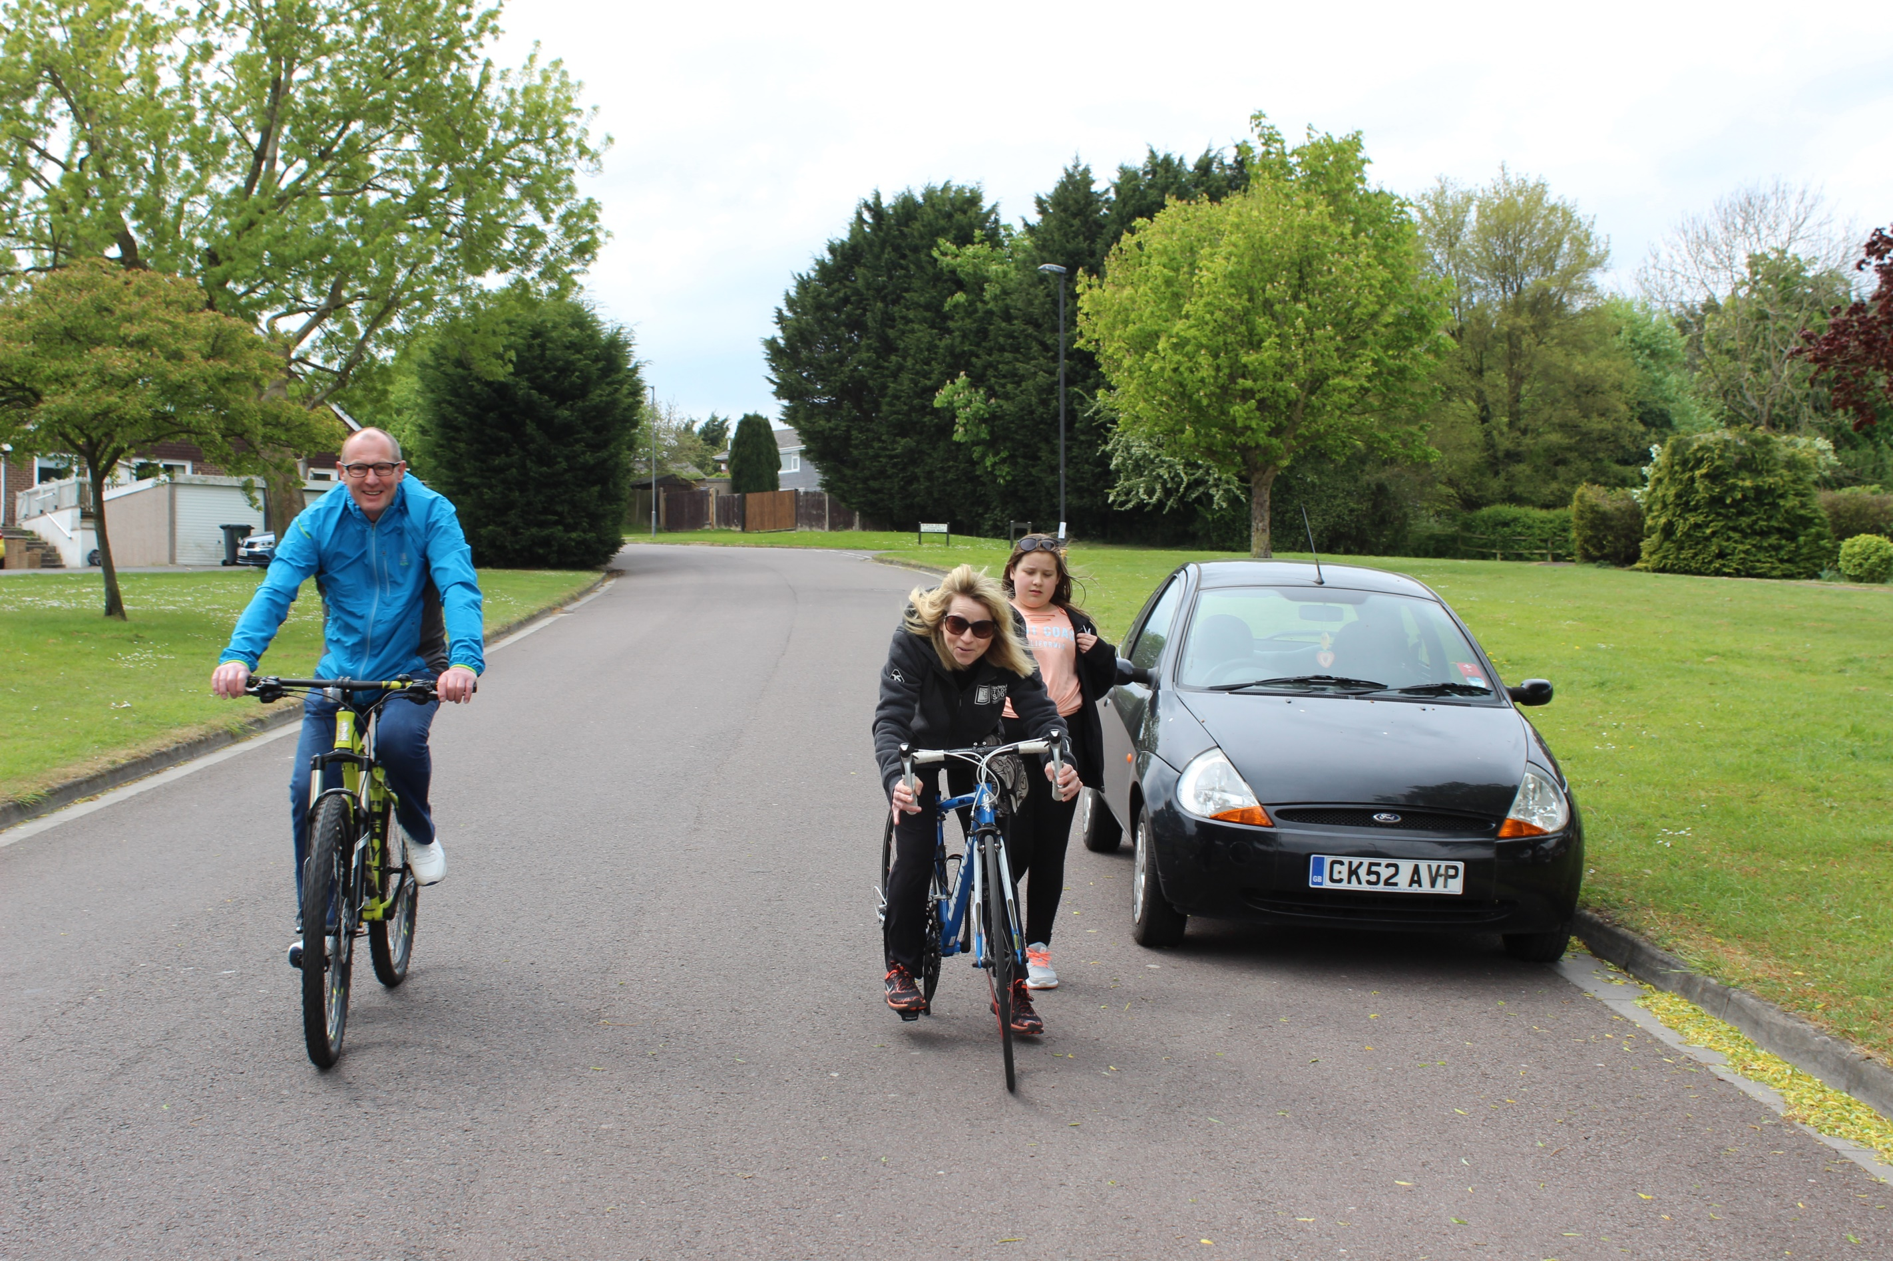
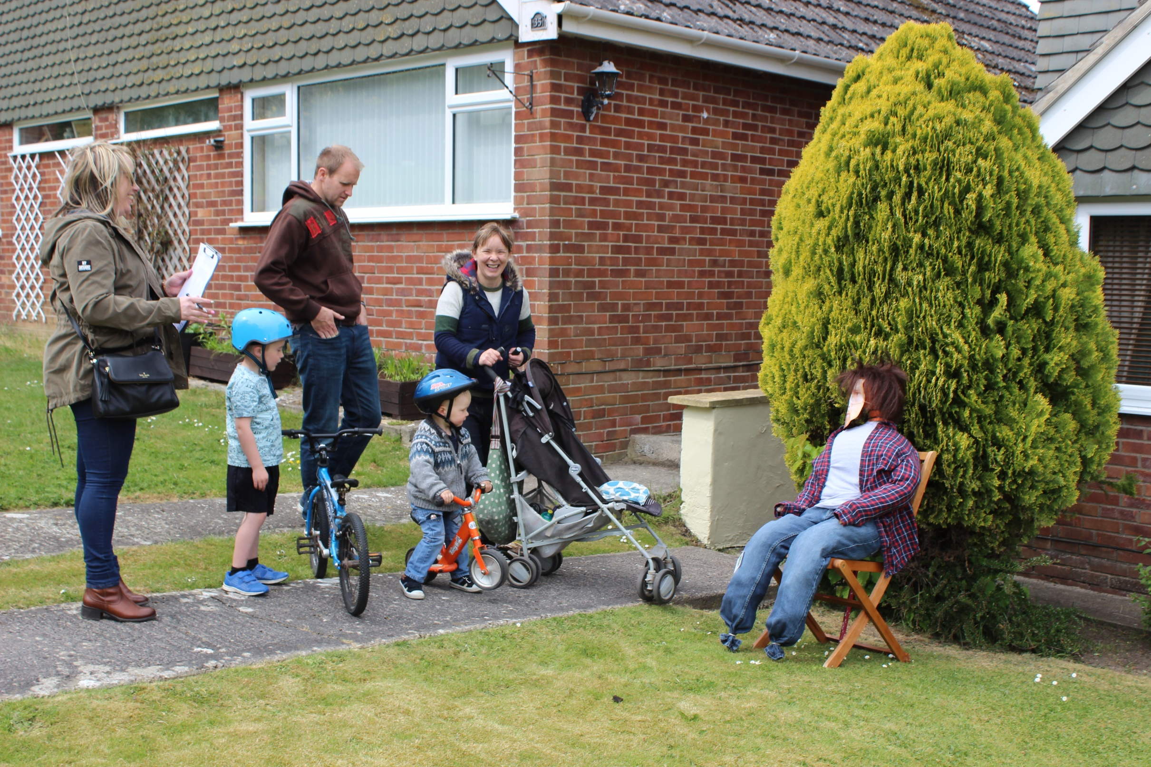

Slide 31
Gotta squirt ‘em all
Squirtle

Slide 32
She has the Power.
She-Ra

Slide 33
A Sweet Magical Person.
Sugar Plum Fairy

Slide 35
Arachnids don’t bother me
Spider Man

Slide 36
Her and Jack are simply meant to be .
Sally (from Nightmare before Christmas

Slide 37
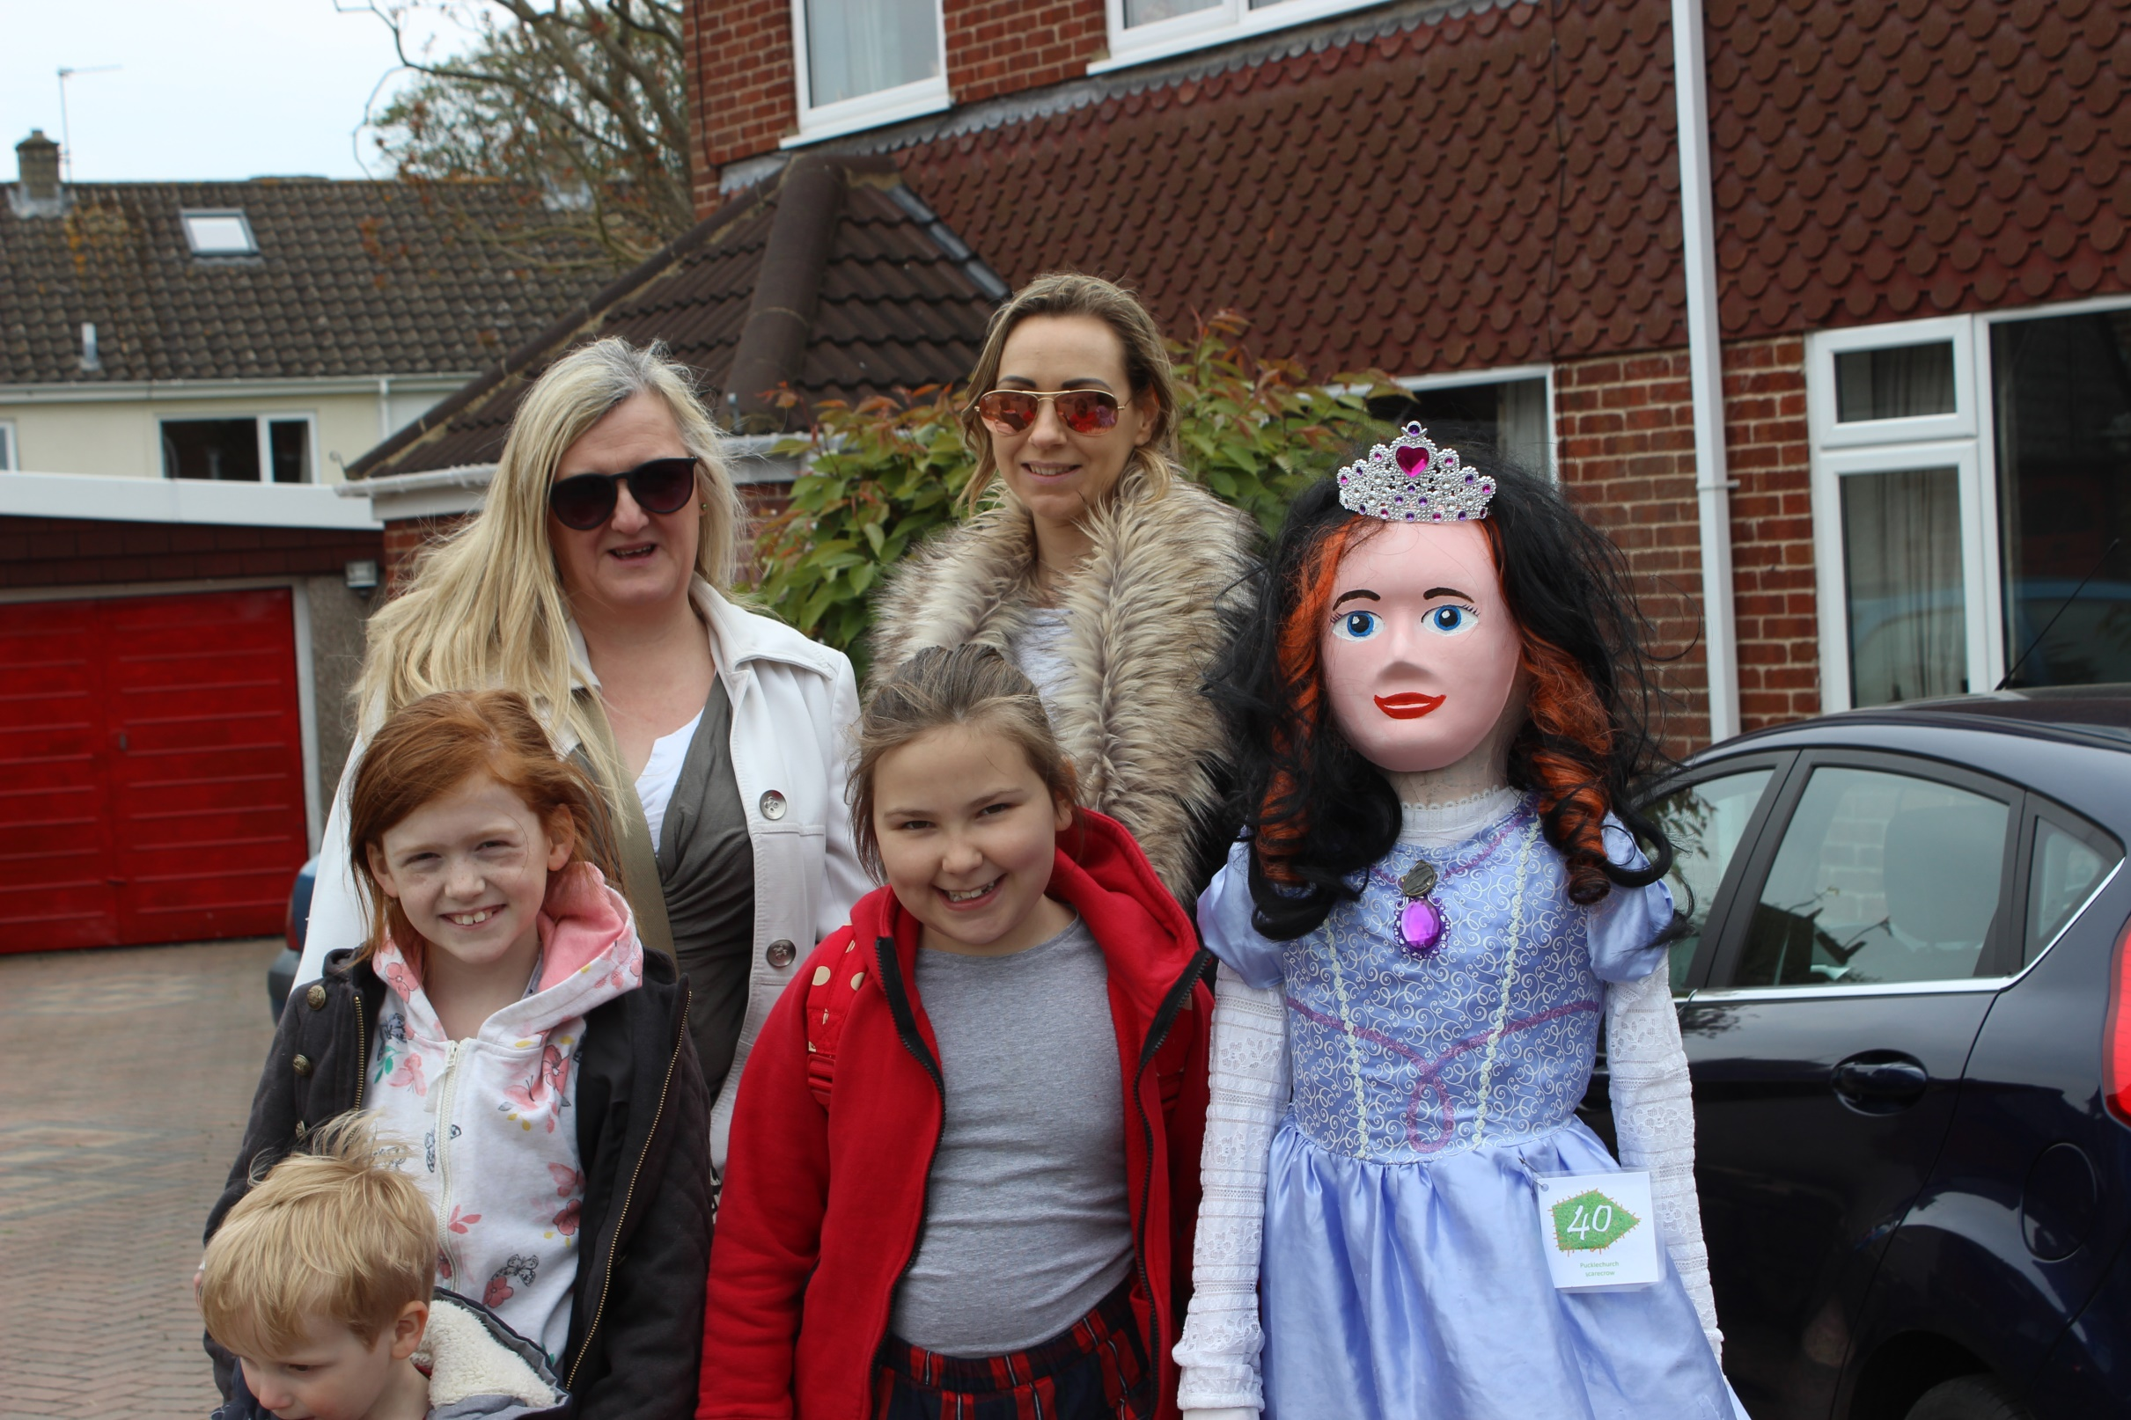

Slide 38
Movies are better with two.
Sergel (Meerkat)

Slide 39
Watch him wriggle, see him squirm, hip, hip hooray.
Superworm

Slide 40
Had we lived, I should have such a tale to tell.
Scott of the Antartic

Slide 41
Lives in a pineapple
Spongebob

Slide 42
This captain protected the Earth from the Mysterons.
Captain Scarlet

Slide 43
Carry on my wayward sun.
Sam Winchester (from TV’s supernatural)

Slide 44
Who do you think you are ?.
Stirling Moss

Slide 45
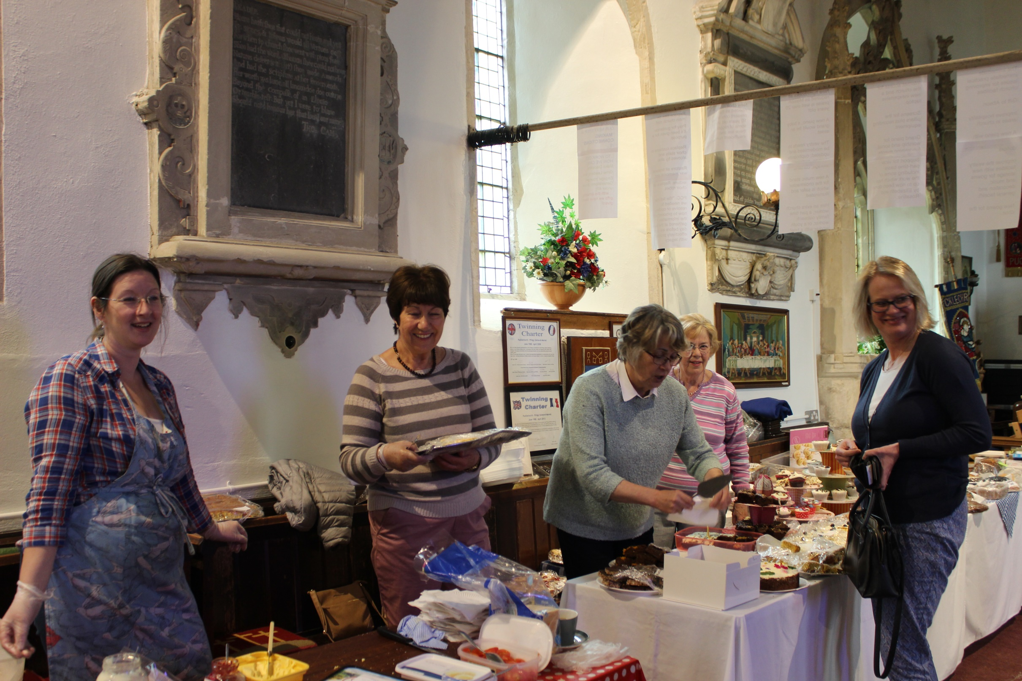
The Cake Ladies

Slide 46
The Dark Side.
Stormtrooper

Slide 47
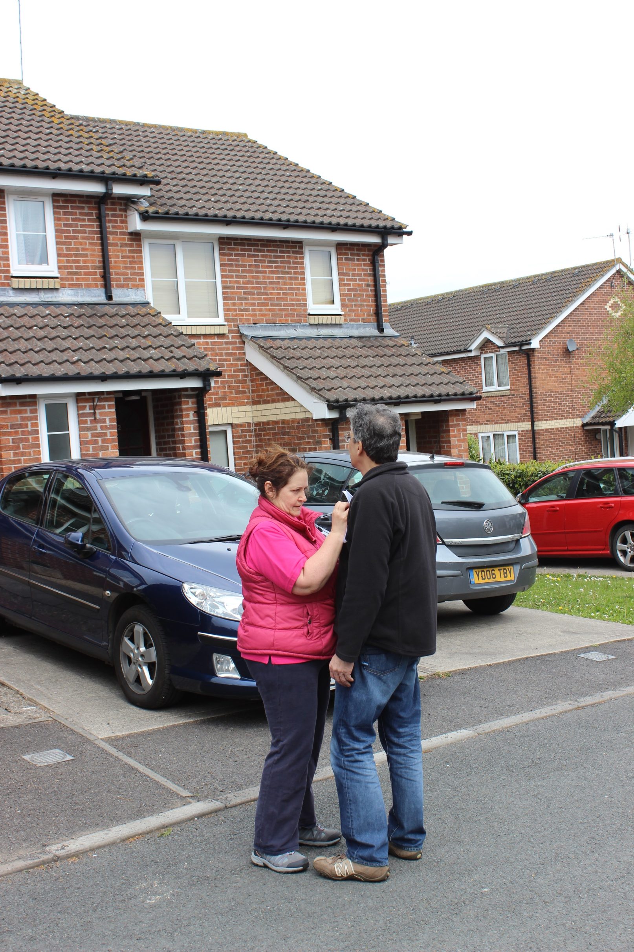

Slide 48
He was a good friend of King John.
Sherriff of Nottingham

Slide 49
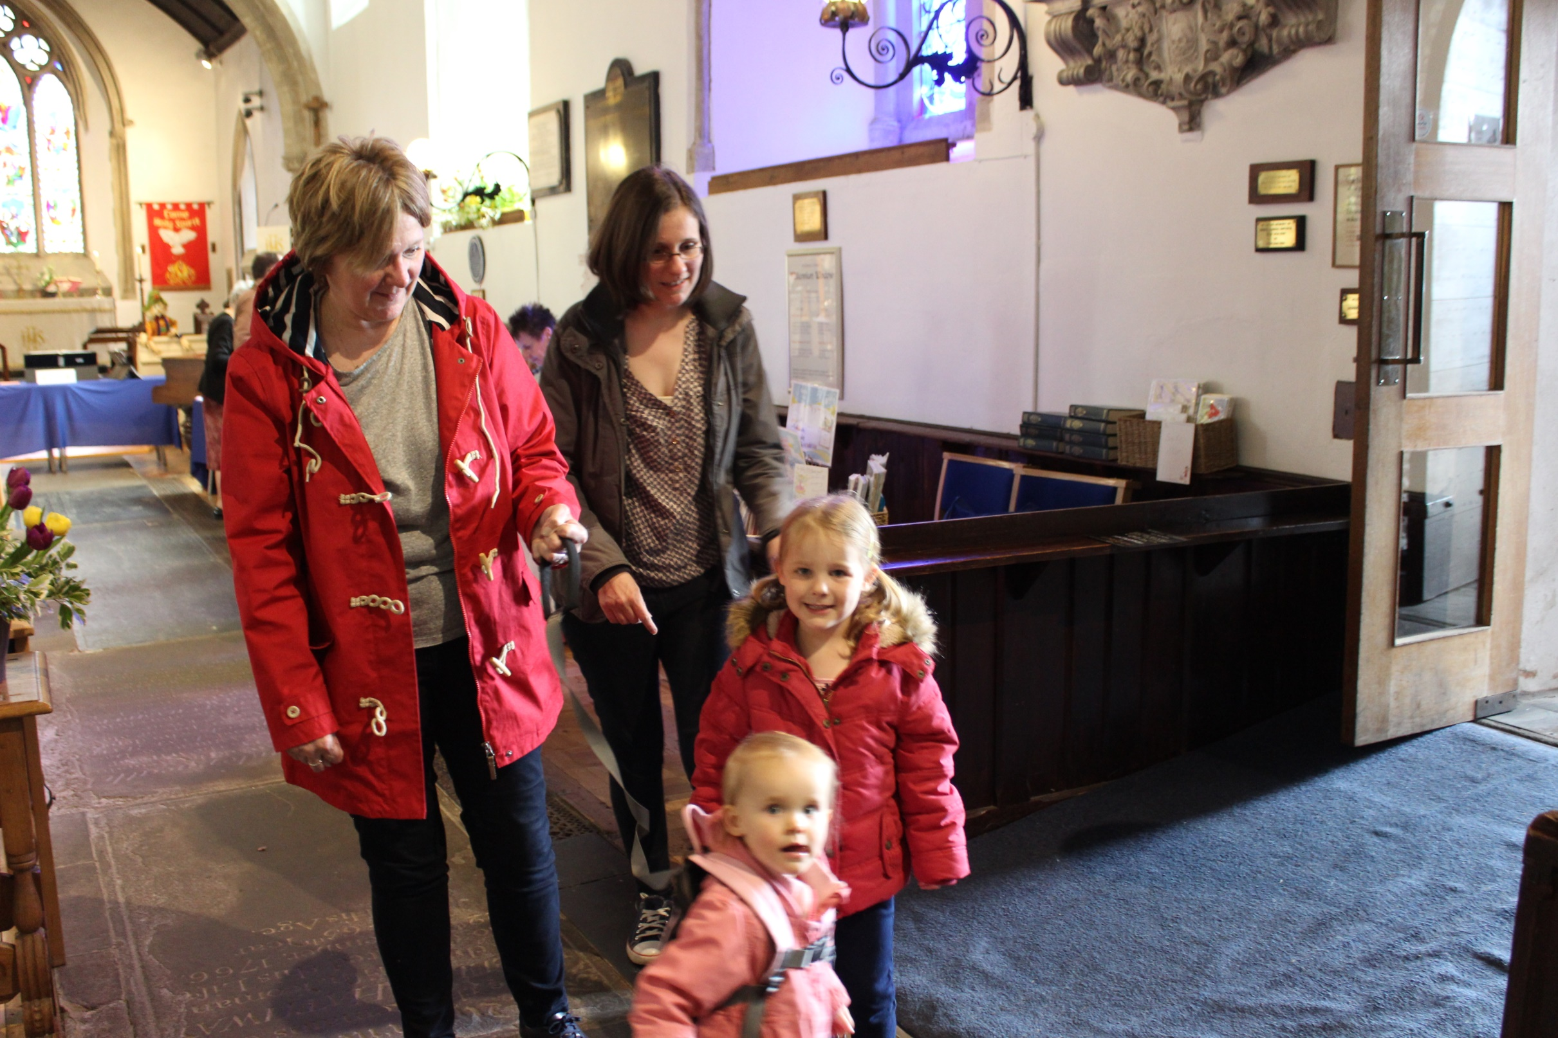

Slide 50
Izzy wizzy lets get busy.
Sooty

Slide 51
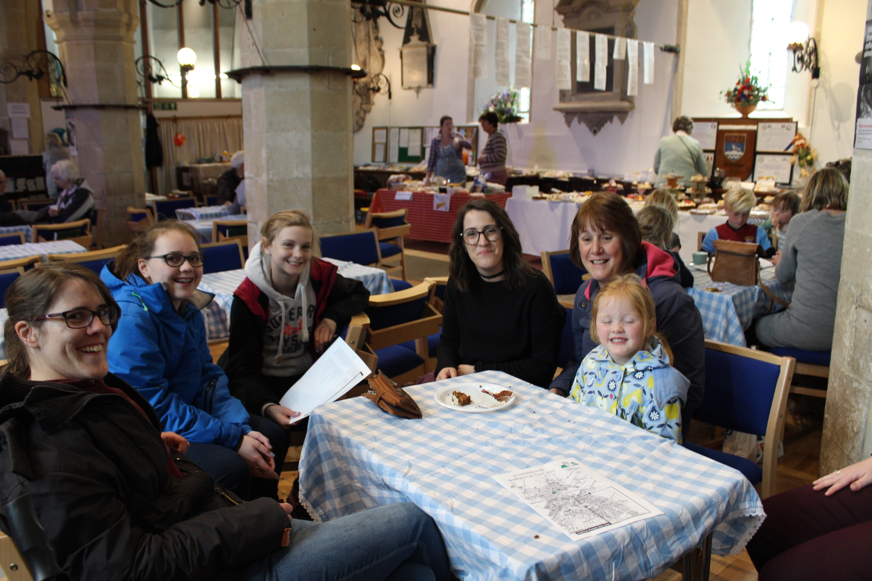

Slide 52
Where is my Prince?
Sleeping beauty

Slide 54
He was with the Spiders from Mars.
Ziggy Stardust

Slide 55
Son of a maths teacher who speaks fluent Japaness and is an Hollywood action Star.
Steven Segal

Slide 56
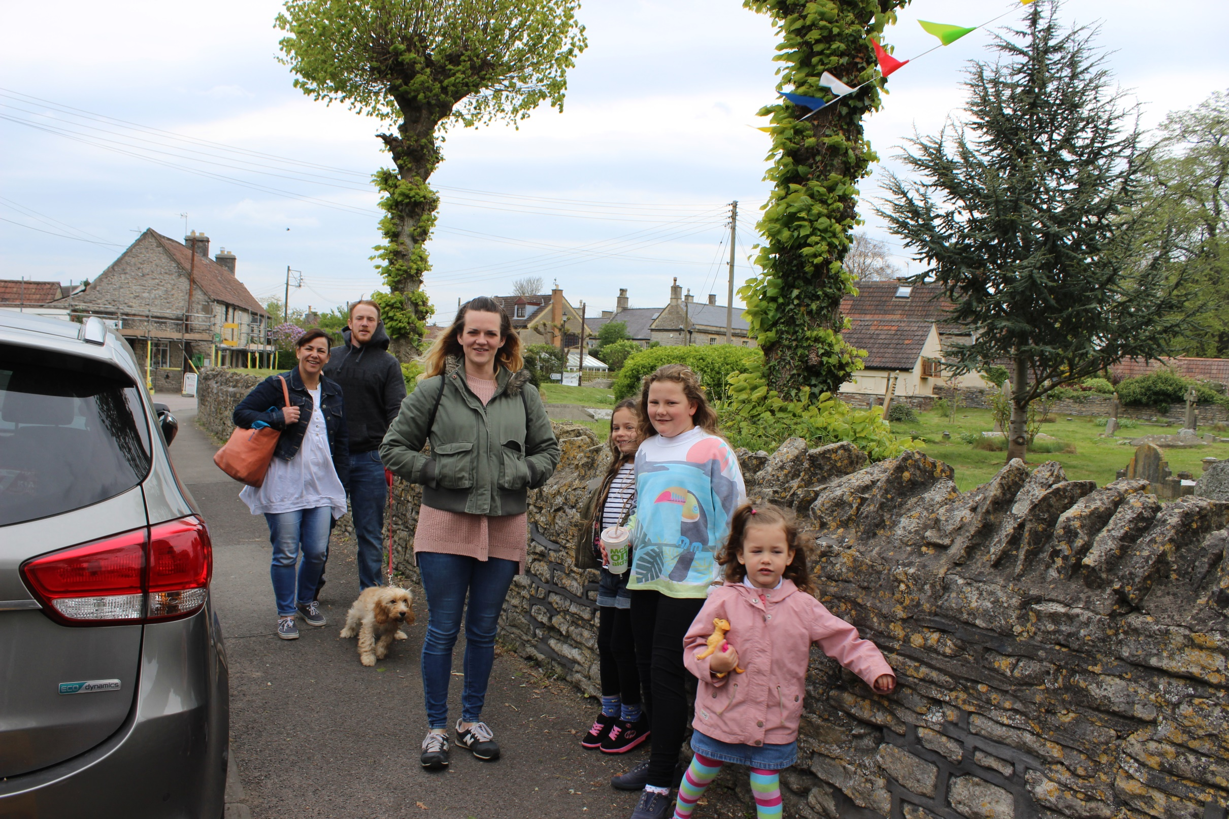

Slide 57
I talk to animals.
Sofia the First

Slide 58
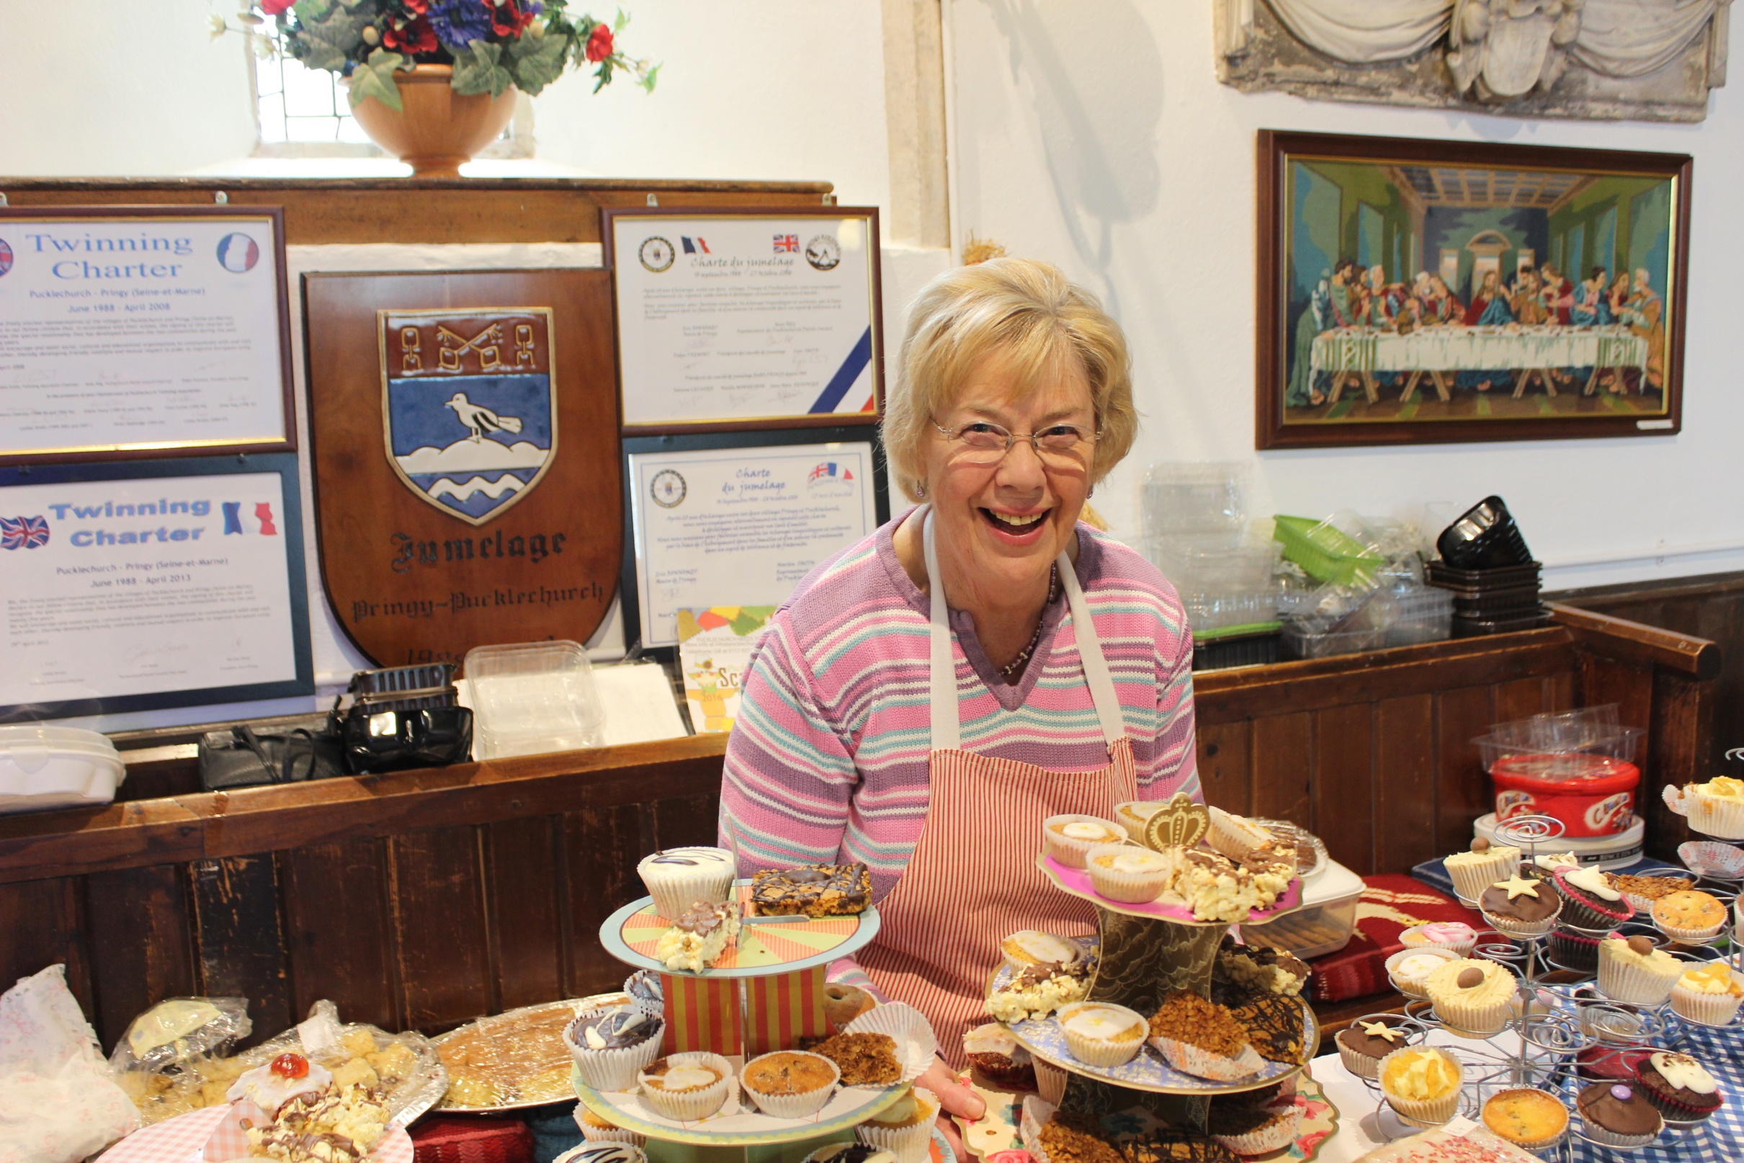

Slide 59
Blue on the inside and on the OUTside too!
Sadness

Slide 60
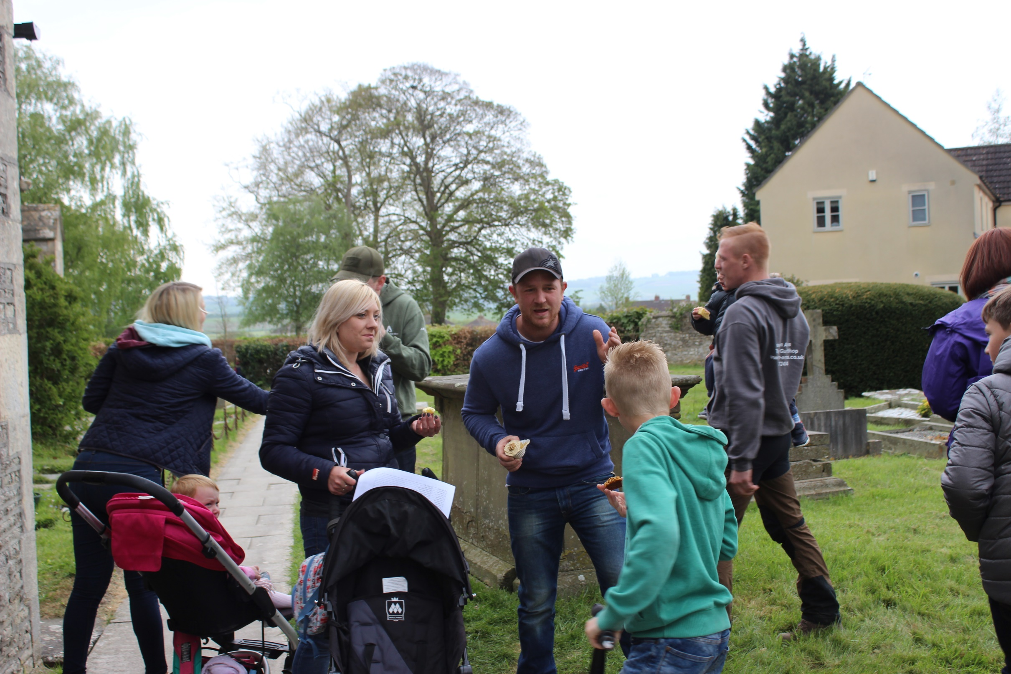

Slide 61
A good friend of W.G.
Aunt Sally.

Slide 62
The designer of the Chupa ChupLollies
Salvador Dali

Slide 63
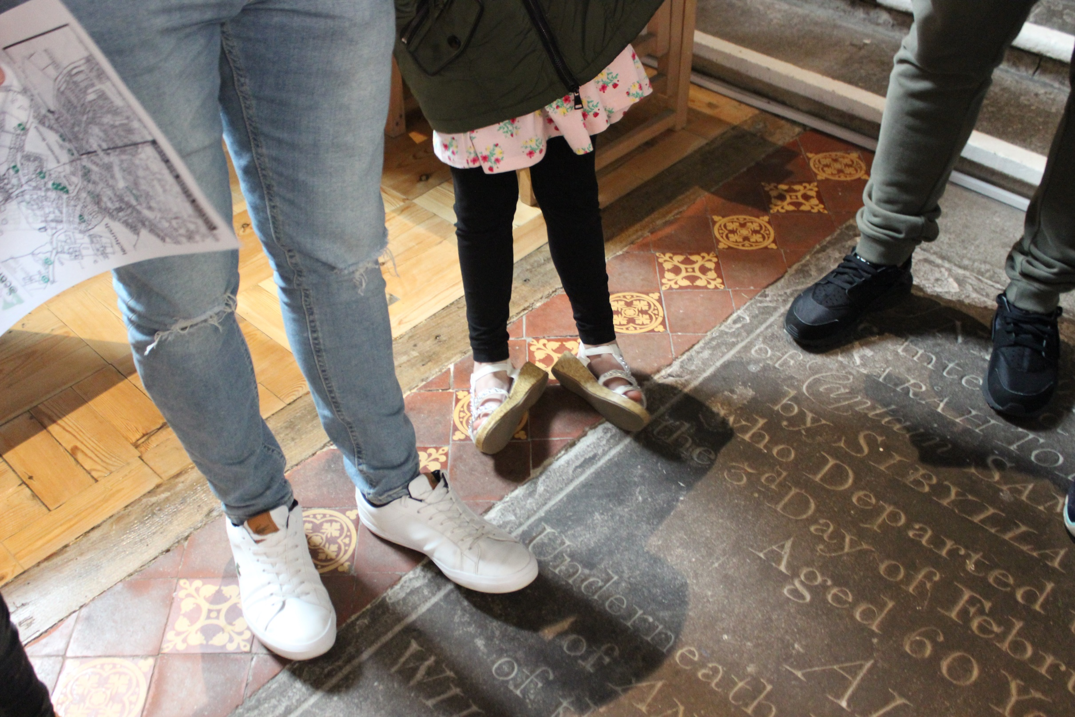
MY FEET ACHE

Slide 64
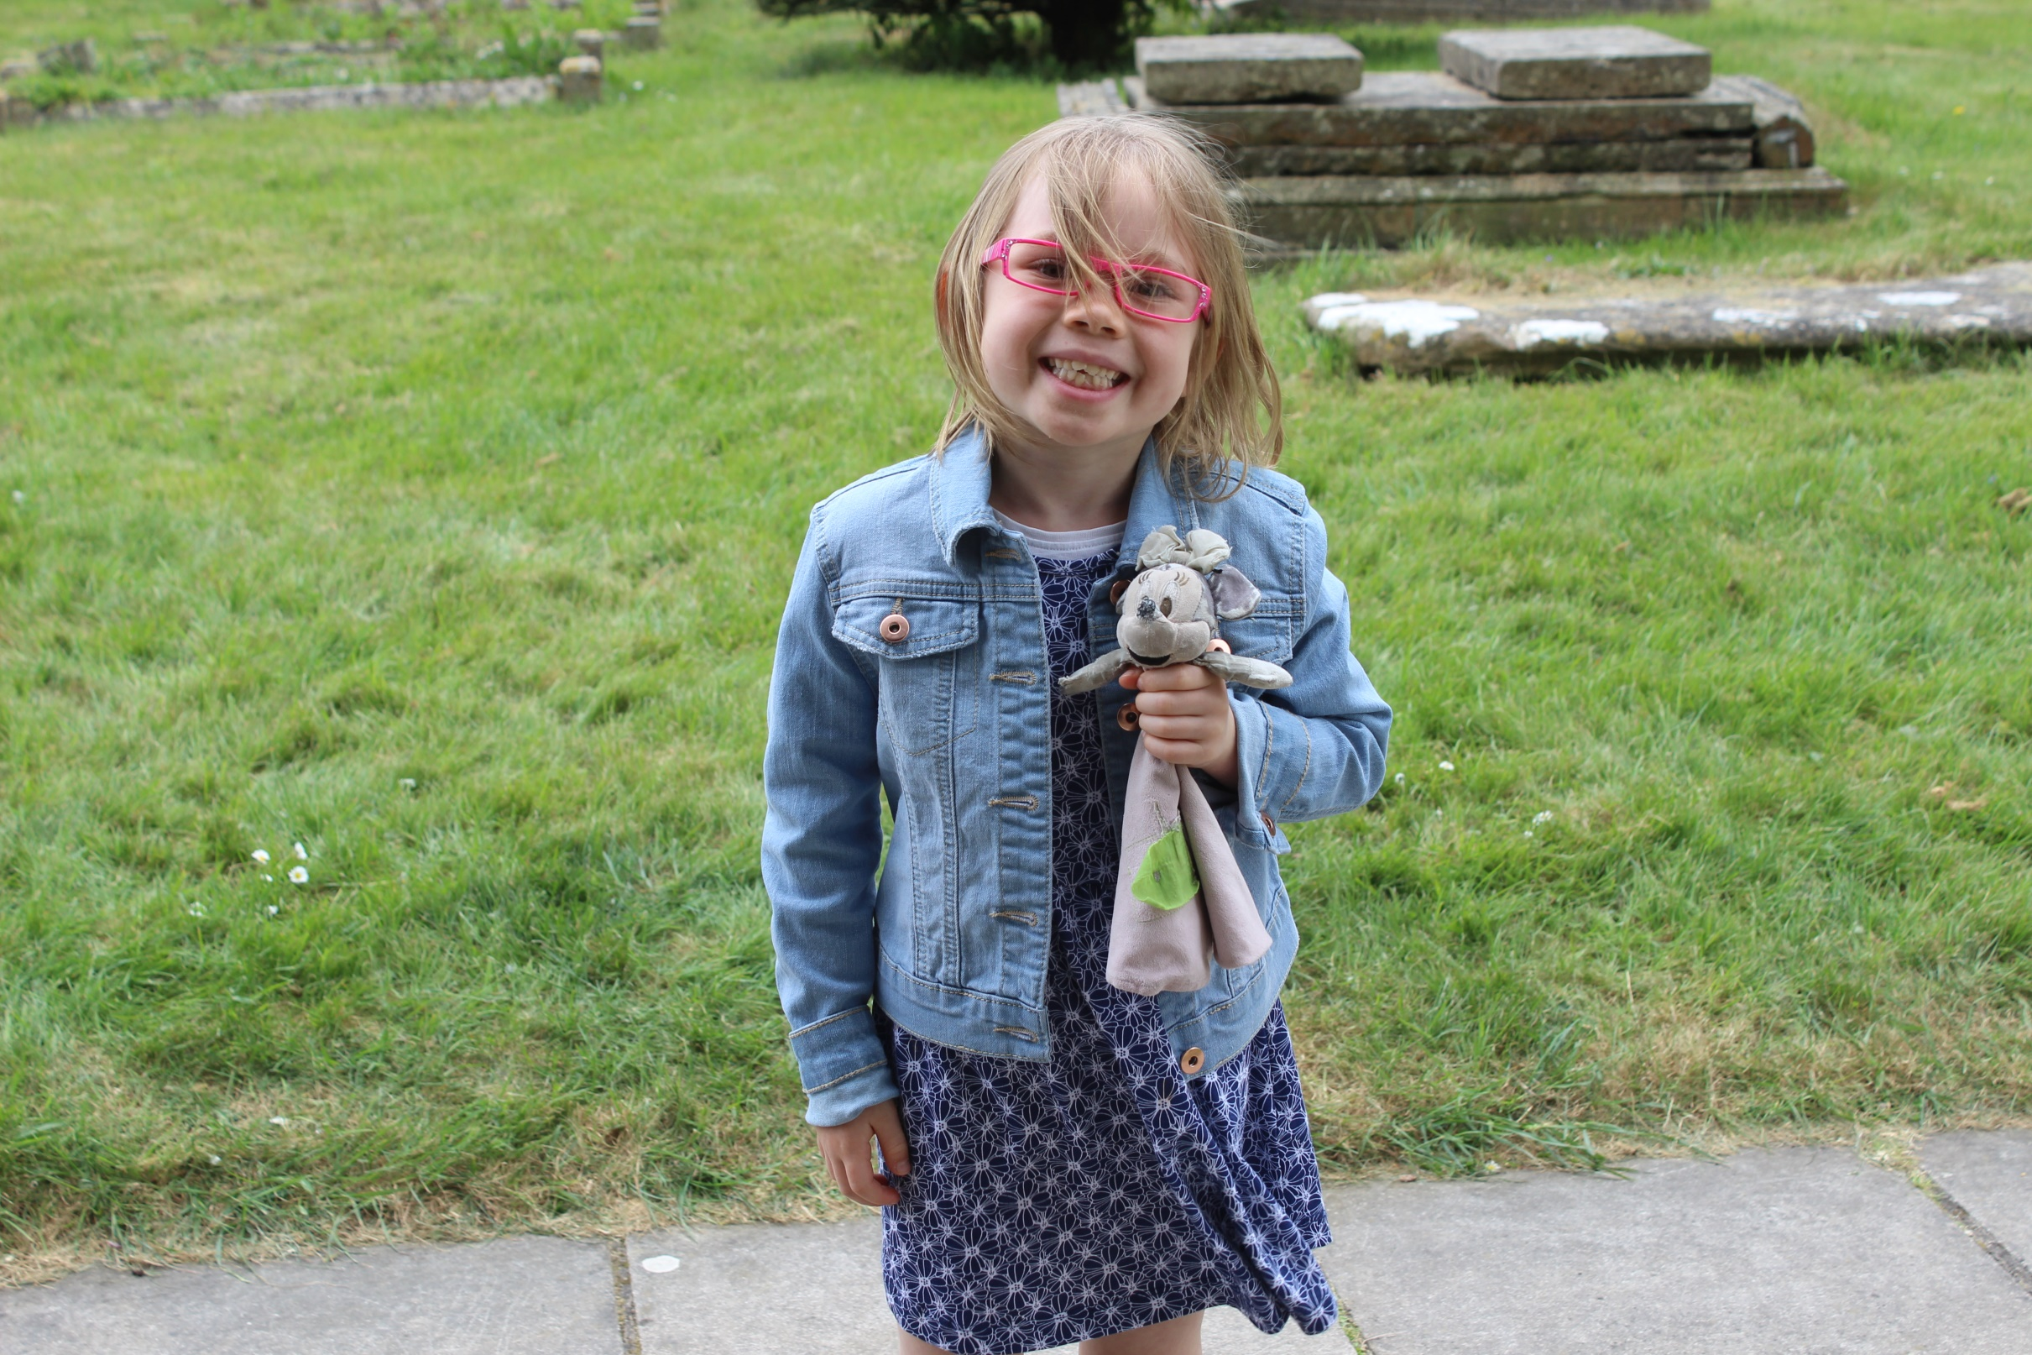
Thank you all for coming,
we will see you next year .

